Slide 1
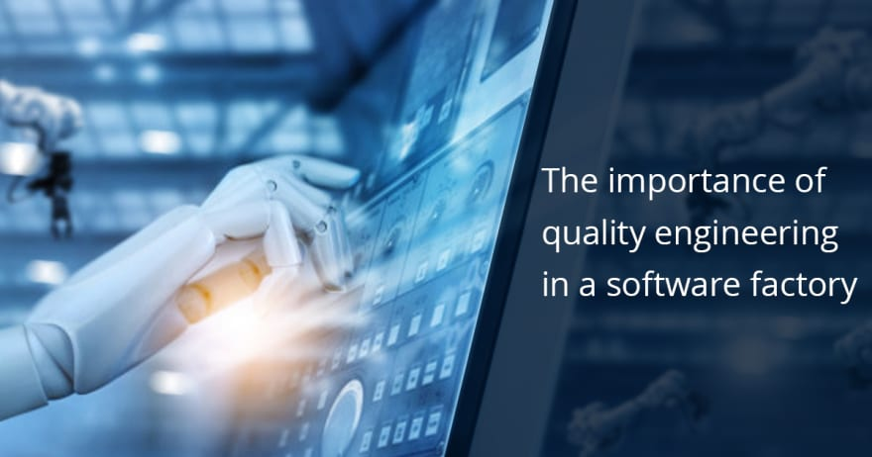
Software QUALITY ENGINERING
SOFTWARE QUALITY AND SOFTWARE QUALITY ENGINEERING

Slide 2
Overview
Marks Distribution

Slide 3
Course outline & Marks Distribution
Quizzes 4 – each of 10 marks
Assignments 2 - each of 5 marks
Project 1 - of 10 marks
Midterm
Final Term

Slide 4
What Is Software?
Software is computer program, procedure and possibly associated documentation and data pertaining to the operation of a computer system. [IEEE]
Software is any set of machine-readable instructions that directs a computer's processor to perform specific operations [WIKIPEDIA]

Slide 5
Software
Computer programs
Procedures
Documentation
Data

Slide 6
What is Software Engineering?
“The application of a systematic, disciplined, quantifiable approach to the development, operation, and maintenance of software” [IEEE]
Software engineering is the study and an application of engineering to design, development, and maintenance of software [WIKIPEDIA]

Slide 7
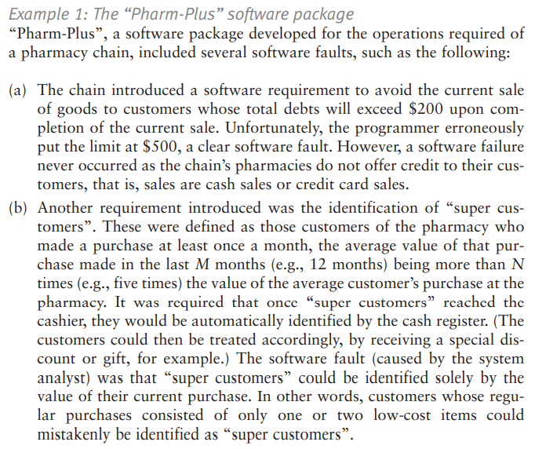

Slide 8
Nine causes of software error
Faulty requirements definition Client–developer communication failures Deliberate deviations from software requirements Logical design errors Coding errors Non-compliance with documentation and coding instructions Shortcomings of the testing process Procedure errors Documentation errors

Slide 9
What Causes Software Errors?
1. Faulty definition of requirements
Erroneous requirement definitions
Absence of important requirements
Incomplete requirements
Unnecessary requirements included
2. Client-developer communication failures
Misunderstanding of client requirements presented in writing, orally, etc.
Misunderstanding of client responses to design problems

Slide 10
What Causes Software Errors?
3. Deliberate deviations from software requirements
Reuse of existing software components from previous projects without complete analysis
Functionality omitted due to budget or time constraints
“Improvements” to software that are not in requirements
4. Logical design errors
Errors in interpreting the requirements into a design (e.g. errors in definitions of boundary conditions, algorithms, reactions to illegal operations,...)
5. Coding errors
Errors in interpreting the design document, errors related to incorrect use of programming language constructs, etc.

Slide 11
What Causes Software Errors?
6. Non-compliance with documentation and coding instructions
Errors resulting from other team members coordinating with non- complying member’s code
Errors resulting from individuals trying to understand/maintain/test non-complying member’s code
7. Shortcomings of the testing process
Incomplete test plan
Failure to report all errors/faults resulting from testing
Incorrect reporting of errors/faults
Incomplete correction of detected errors

Slide 12
What Causes Software Errors?
8. Procedural errors
Incorrect procedures related to user activities that occur in the software
9. Documentation errors
Errors in the design documents or code comments
Errors in user manuals for software

Slide 13
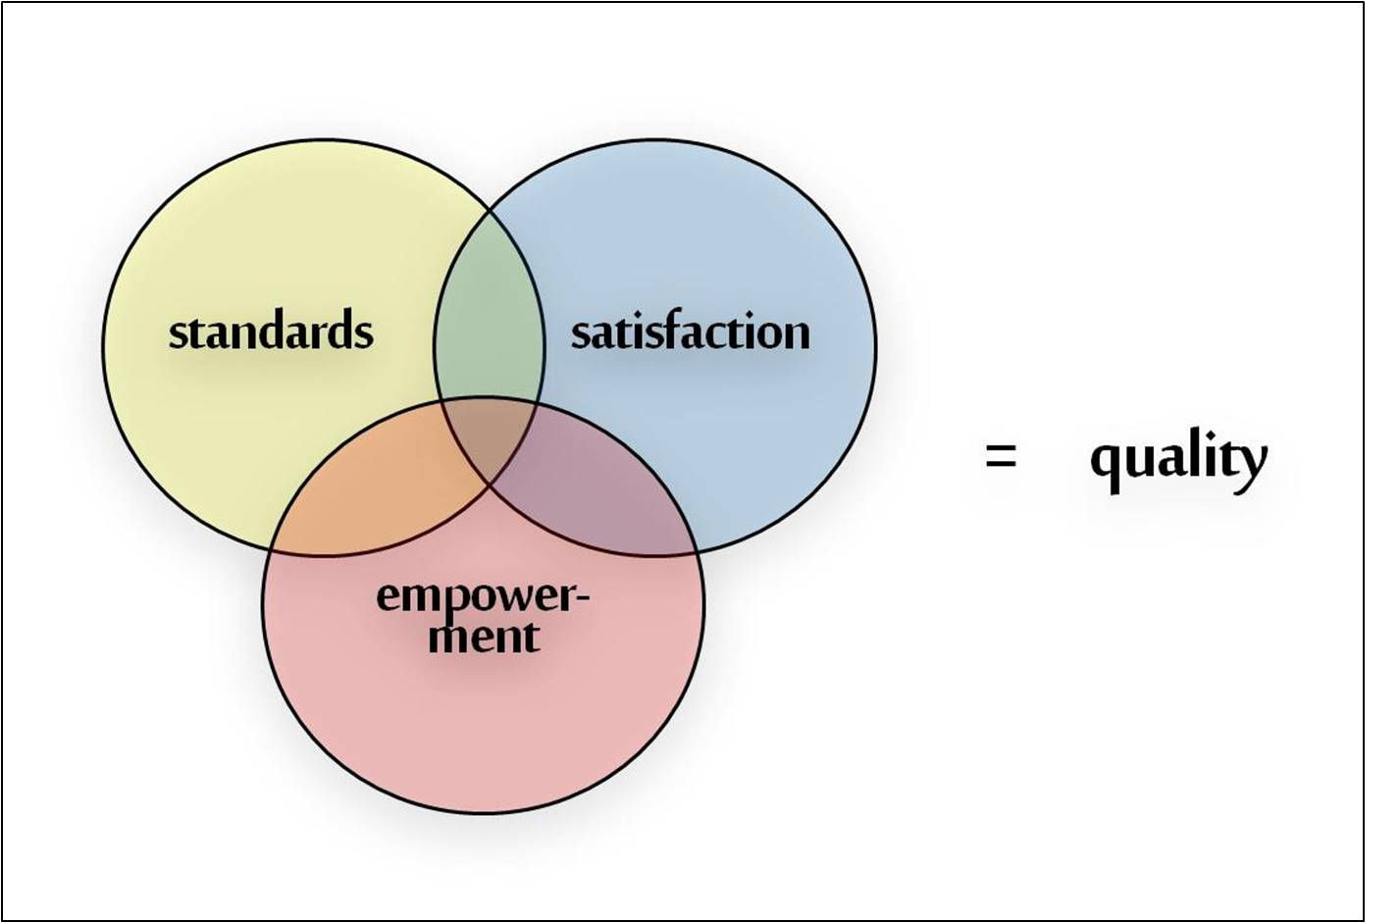
Quality Evolution

Slide 14
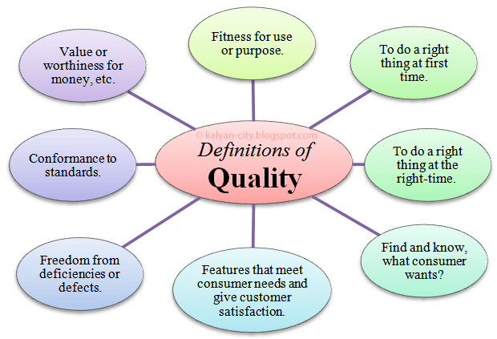
Definition of term “Quality”

Slide 15
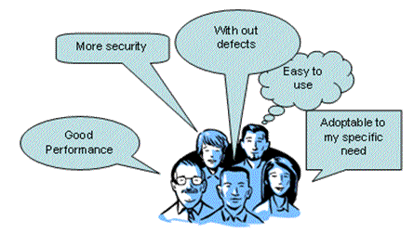
Quality ! What Is It ?
Quality Not a single idea
many aspects
Popular View
In everyday life, usually thought of as intangible, can be felt or judged, but not weighed or measured
“I know it when I see it” - implies that it cannot be controlled, managed, or quantified
The standard of something measured against other similar things, OR the degree of excellence of something
Notes:
Intangible : Assets that are saleable though not material or physical

Slide 16
Professional View
Professional View
In a profession such as software development, there is an ethical imperative to quality. It is a moral and legal requirement
We have a professional responsibility associated with the software we create
In practical terms, product quality must be measurable in some way
Product quality is spoken of in terms of
Conformance to requirements - including timeliness, cost
Fitness for use - does it actually do the job?
Freedom from errors and failures - is it reliable and robust?
Customer satisfaction - are users happy with it?

Slide 17

What is Software Quality?
Software Quality is:
The degree to which a system, component, or process meets specified requirements
[Philip B. Crosby’s definition, 1979]
The degree to which a system, component or process meets customer or user needs or expectations.
[Joseph M. Juran, 1988]

Slide 18
Software Quality?
Software quality is normally spoken of in terms of several different dimensions often called quality parameters
These can be split (roughly) into two groups
Technical Quality Parameters
User Quality Parameters

Slide 19
Technical Quality Parameters
Correctness - lack of bugs and defects
measured in terms of defect rate (# bugs per line of code)
Reliability - does not fail or crash often
measured in terms of failure rate (#failures per hour)
Capability - does all that is required
measured in terms of requirements coverage (% of required operations implemented)

Slide 20
Technical Quality Parameters
Maintainability - is easy to change and adapt to new requirements
measured in terms of change logs (time and effort required to add a new feature) and impact analysis (#lines affected by a new feature)
Performance - is fast and small enough
measured in terms of speed and space usage (seconds of CPU time, Mb of memory, etc.)

Slide 21
User Quality Parameters
Usability - is sufficiently convenient for the intended users
measured in terms of user satisfaction (% of users happy with interface and ease of use)
Install-ability - is convenient and fast to install
measured in terms of user satisfaction (#install problems reported/ installation)
Documentation - is well documented
measured in terms of user satisfaction (% of users happy with documentation)
Availability - is easy to access and available when needed
measured in terms of user satisfaction (% of users reporting access problems)

Slide 22
Problems
Loss of Money
Time
Business Reputation
Injury or Death
“We need to check everything and anything we produce because things can always go wrong – humans make mistakes all the time.”

Slide 23
Testing Cycle
Finding errors
Measure SW Quality
Measure and improve quality

Slide 24
Why Software quality?
Center of gravity shifts from creating an engineering solution to satisfying the stakeholders.
Trend within the community of stakeholders “I do not want to know about bits and bytes, I want a solution that satisfies my needs”

Slide 25
Why Software quality?
Critical word “satisfaction”
The process of verifying and validating that a software program, application or product covers both:
Meets the business and technical requirements
Works as expected
Notes:
User satisfaction=compliant product +delivery within budget and schedule

Slide 26

Cognition in Testing

Slide 27
Cognition in Testing

Slide 28
Cognition in Testing

Slide 29
Cognition in Testing

Slide 30
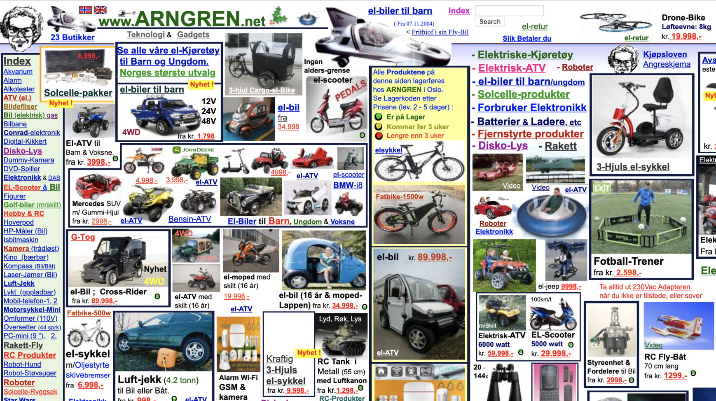

Max Information Bad Design

Slide 31
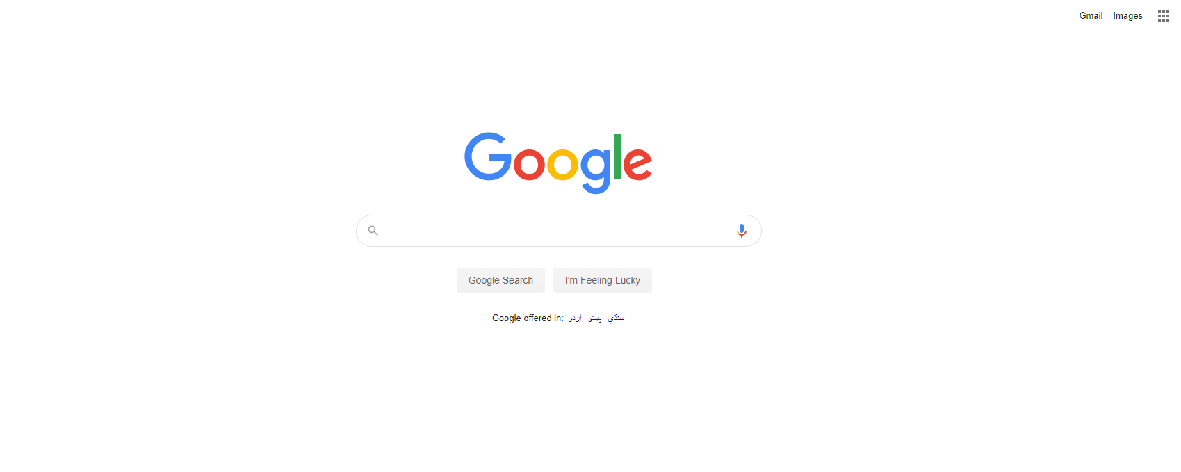
Less Information Good Design

Slide 32

Less Information Good Design

Slide 33

Cognition in Testing
Cognitive QA connects quality to desired business outcomes; minimizing risk and rapidly delivering high quality software and products to market with optimal cost savings for an enhanced customer experience and a stronger brand reputation

Slide 34
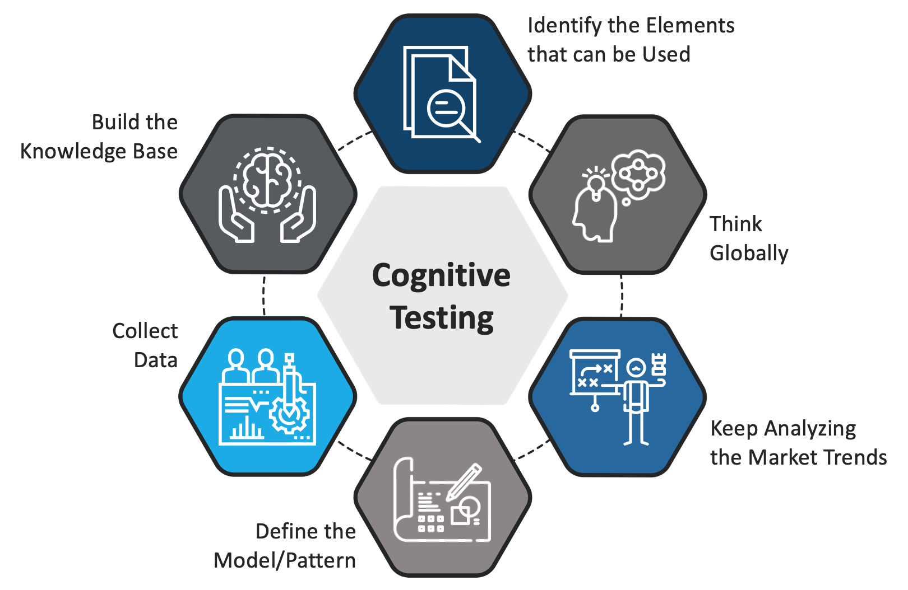

Slide 35
Key Aspects of Quality:
Good design – looks and style
Good functionality – it does the job well
Reliable – acceptable level of breakdowns or failure
Consistent
Durable – lasts as long as it should
Good after sales service
Value for money

Slide 36
Quality vs Testing
?
GOOD QUALITY
MERCEDES-BENZ OR SUZUKI MEHRAN
Popular View
Class
Technical View
Satisfaction
Time Budget and Scope
“TESTING is the measurement of QUALITY”

Slide 37
Software Quality
Meeting the customer’s requirement
At agreed cost
Within the agreed timelines
Software Quality

Slide 38
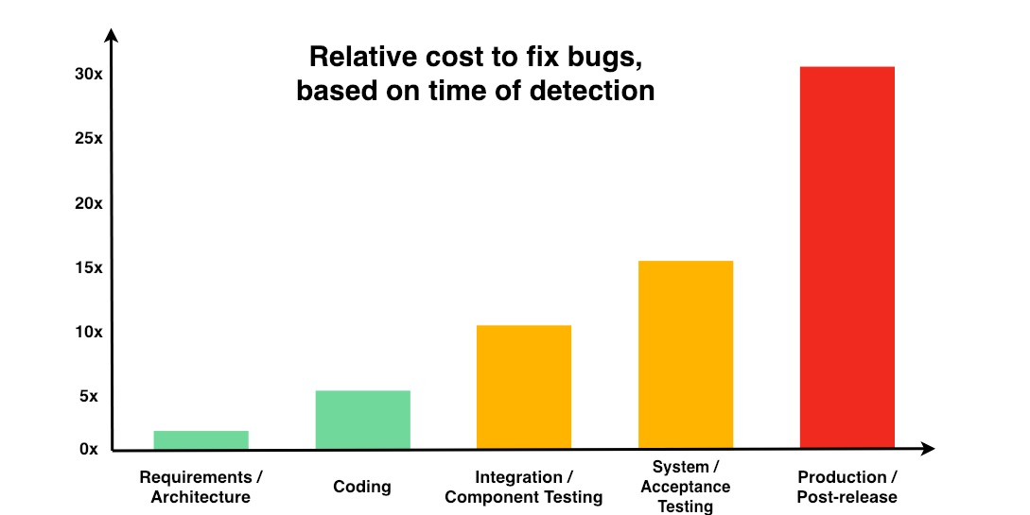
Cost of Defect

Slide 39
General Testing Terms
?
Bug
Defect
Error
Mistake
Fault
Failure

Slide 40
General Testing Terms
“A human being can make an error (mistake), which produces a defect(fault, bug) in the program, code or in a document. If a defect in code is executed, the system may fail to do what is should do (or do something it shouldn’t), causing a failure.”
Defects in software, systems or documents may result in failures, but not all defects do so.

Slide 41
Quality Assurance vs Quality Control
Definition
QA is a set of activities for ensuring quality in the processes by which products are developed
QC is a set of activities for ensuring quality in products. The activities focus on identifying defects in the actual products produced

Slide 42
Quality Assurance vs Quality Control
Focus on
QA aims to prevent defects with a focus on the process used to make the product. It is a proactive quality process.
QC aims to identify (and correct) defects in the finished product. Quality control, therefore, is a reactive process

Slide 43
Quality Assurance vs Quality Control
What
QA is prevention of quality problems through planned and systematic activities including documentation.
QC is the set of activities or techniques used to achieve and maintain the product quality

Slide 44
Quality Assurance vs Quality Control
Tools
QA is managerial tool. QC is corrective tool.
Orientation
QC is product oriented
QA is process oriented

Slide 45
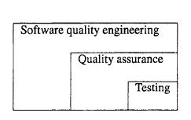
Testing, Quality Assurance, and Quality Engineering
Testing
By running the software system or executing its prescribed functions, testers can determine if the observed system behavior conforms to its specifications or requirements.
Quality Assurance
There are many other QA alternatives supported by related techniques and activities, such as inspection, formal verification, defect prevention, and fault tolerance.
Quality Engineering
All these QA activities need to be managed in an engineering process we call the software quality engineering process, with quality goals set early in the product development, and strategies for QA selected, carried out, and monitored to achieve these preset quality goals.

Slide 46
Achieving Quality
Product and software quality does not happen by accident, and is not something that can be added on after the fact
To achieve quality, we must plan for it from the beginning, and continuously monitor it day to day
This requires discipline
Methods and disciplines for achieving quality results are the study of Quality Assurance or QA

Slide 47
Achieving Quality
Three General Principles of QE
Know what you are doing
Know what you should be doing
Know how to measure the difference

Slide 48
QA Principal 1
Know What You Are Doing
In the context of software quality, this means continuously understanding what it is you are building, how you are building it and what it currently does
This requires organization, including a management structure, reporting policies, regular meetings and reviews, frequent test runs, and so on

Slide 49
QA Principal 1
We normally address this by following a software process with regular milestones, planning, scheduling, reporting and tracking procedures

Slide 50
QA Principal 2
Know What You Should be Doing
In the context of software quality, this means having explicit requirements and specifications
These must be continuously updated and tracked as part of the software development and evolution cycle

Slide 51
QA Principal 2
We normally address this by requirements and use-case analysis, explicit acceptance tests with expected results, explicit prototypes, frequent user feedback
Particular procedures and methods for this are usually part of our software process
Notes:
A use case is a methodology used in system analysis to identify, clarify, and organize system requirements

Slide 52
QA Principal 3
Know How to Measure the Difference
In the context of software quality, this means having explicit measures comparing what we are doing to what we should be doing
Achieved using four complementary methods:
Formal Methods - consists of using mathematical models or methods to verify mathematically specified properties
Testing - consists of creating explicit inputs or environments to exercise the software, and measuring its success

Slide 53
QA Principal 3
Inspection- consists of regular human reviews of requirements, design, architecture, schedules and code
Metrics- consists of instrumenting code or execution to measure a known set of simple properties related to quality
A measure of some property of a piece of software or its specifications.

Slide 54

Software Quality
To Customers:
Satisfaction
Improved Reliability
Reduced Errors in Operations
Matching with Requirements
To the Organization:
Meeting Customer Requirements
Stable Requirements
Verification that Requirements are Met
Consistent Application of Processes
Improvement Over Time

Slide 55
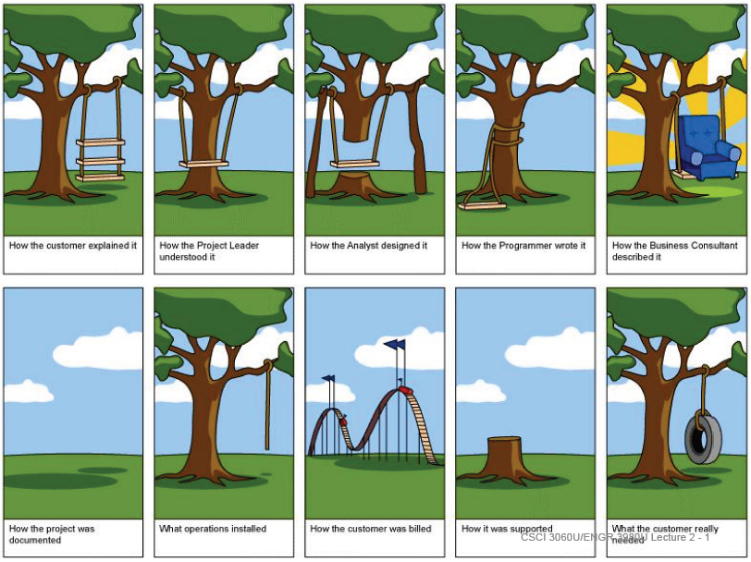

Slide 56
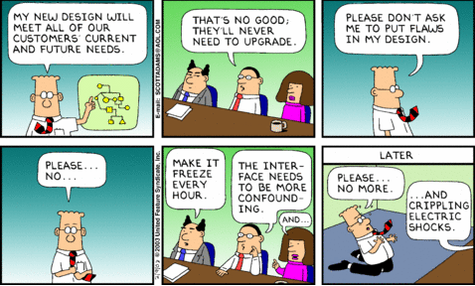
Real World Software Development

Slide 57
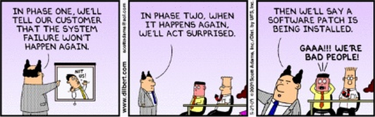
Real World Software Development

Slide 58

END OF LECTURE
Any Questions !!!

